Slide 1
SPAM EMAIL DETECTION WITH SENTIMENT ANALYSIS
Project Group 5 members:
Danda Reethika Reddy
Surya Sai Raj Lakkoju,
Ashesh Pinisetti, and
Mohammad Khaja Moinuddin

Slide 2
GOAL OF THE PROJECT
To improve the accuracy and effectiveness of spam detection using sentiment analysis with a random forest machine learning model
SIGNIFICANCE OF THE PROJECT:
To identify and classify spam emails to help users avoid fraud and protect against malicious content also running the sentiment analysis.

Slide 3
OVERVIEW OF SPAM EMAIL DETECTION METHODS
Explanation of sentiment analysis and how it can improve spam detection
Sentiment analysis is the process of identifying and categorizing the emotional tone expressed in a piece of text, whether it's positive, negative or neutral. This is done using natural language processing techniques to analyze the words and context of the text.
By incorporating sentiment analysis into spam detection algorithms, it's possible to identify and filter out unwanted messages that contain negative sentiment. For example, spam emails that contain angry or aggressive language are more likely to be flagged as suspicious and filtered out.

Slide 4
VADER SENTIMENT LIBRARY FOR SENTIMENT ANALYSIS
Vader sentiment library is a popular open-source Python library used for sentiment analysis of text.
The library uses a rule-based approach to analyze the sentiment of text, taking into account not only individual words, but also the context and the grammatical structure of the sentence.
Vader sentiment library is known for its ability to handle nuances of sentiment in text, such as sarcasm and irony, and can classify text into positive, negative or neutral sentiment with a high degree of accuracy.

Slide 5
METHODOLOGY
Random forest machine learning model trained with a dataset
Data preprocessing steps, including email content extraction, text classification, pattern validation, and tokenization
Use of the vaderSentiment library to classify sentiment into positive, negative, or neutral
Evaluation methods used, including confusion matrix, classification report, accuracy, precision and recall, and F1 score

Slide 6
RELATED WORK
Sentiment analysis using unlabeled dataset.
A Comprehensive Review on Email Spam Classification using Machine Learning Algorithms
An email classification model based on rough set theory
Sentiment Analysis for Fake News Detection by Means of Neural Networks
Novel email spam detection method using sentiment analysis and personality recognization.

Slide 7
DATASET
Using Dataset from Kaggle
Here, we are using Phishing_Legitimate_full.csv
The dataset contains 48 features extracted from 10,000 web pages, consisting of 5,000 phishing web pages and 5,000 legitimate web pages. The web pages were downloaded from January to May 2015 and from May to June 2017. The dataset's primary purpose is to be used for machine learning-based phishing detection, where the features can be used to train and evaluate machine learning models that can classify a given webpage as either a phishing webpage or a legitimate web page. Each of the 10,000 web pages in the dataset is labeled as either a phishing webpage or a legitimate webpage. This means that the dataset is a supervised learning dataset, where the machine learning model can learn from the labeled examples to make predictions on new, unlabeled web pages.

Slide 8
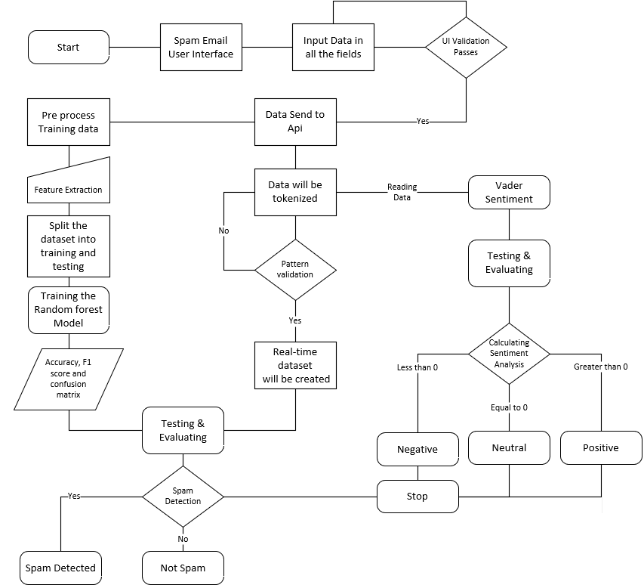
ARCHITECTURE DIAGRAM :

Slide 9
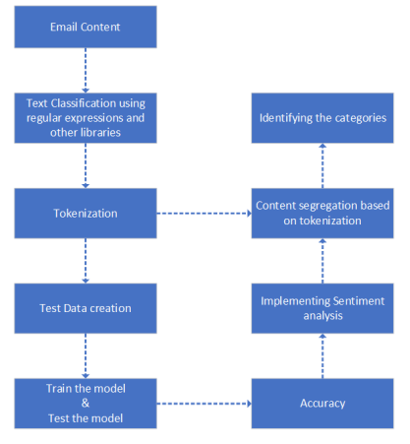
WORKFLOW DIAGRAM :

Slide 10
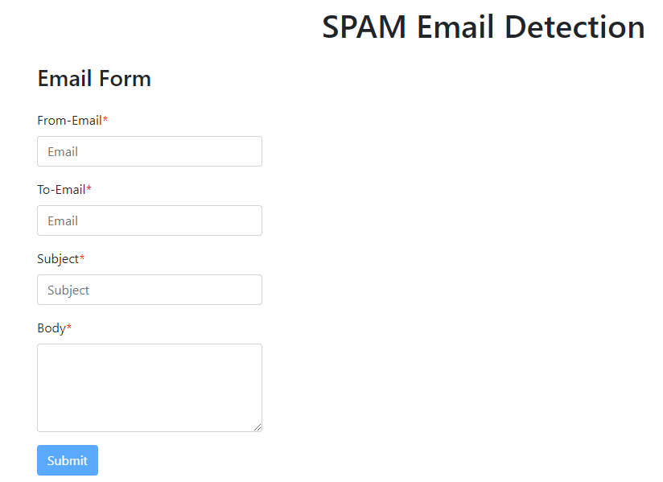
SCREENSHOTS:

Slide 11
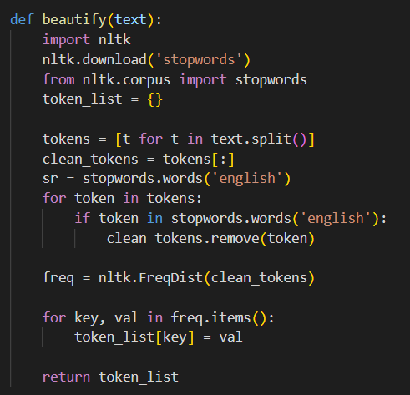
SCREENSHOTS:

Slide 12
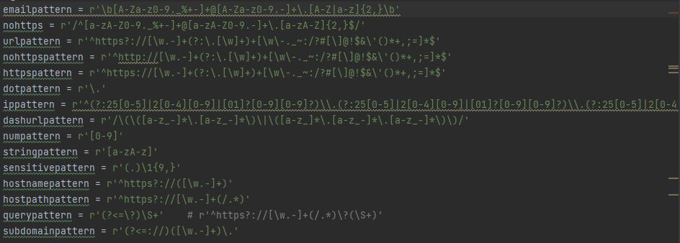
SCREENSHOTS:

Slide 13
SCREENSHOTS:

Slide 14
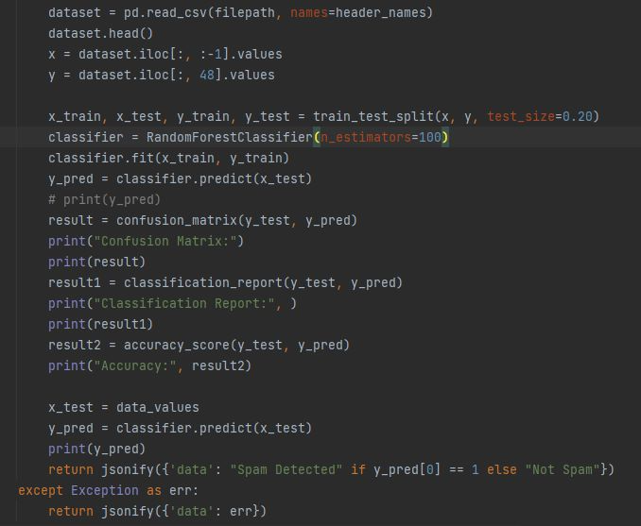
SCREENSHOTS:

Slide 15
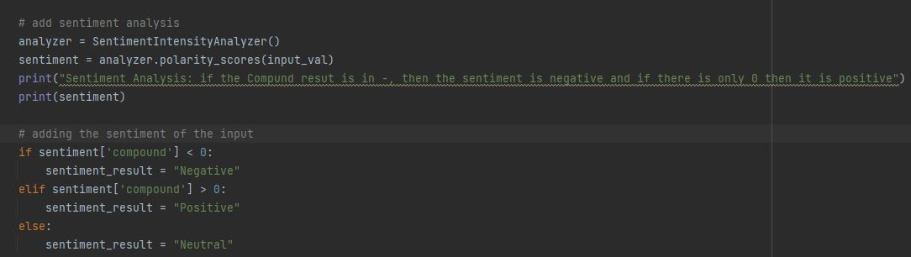
SCREENSHOTS:

Slide 16
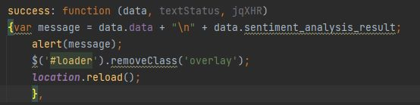
SCREENSHOTS:

Slide 17
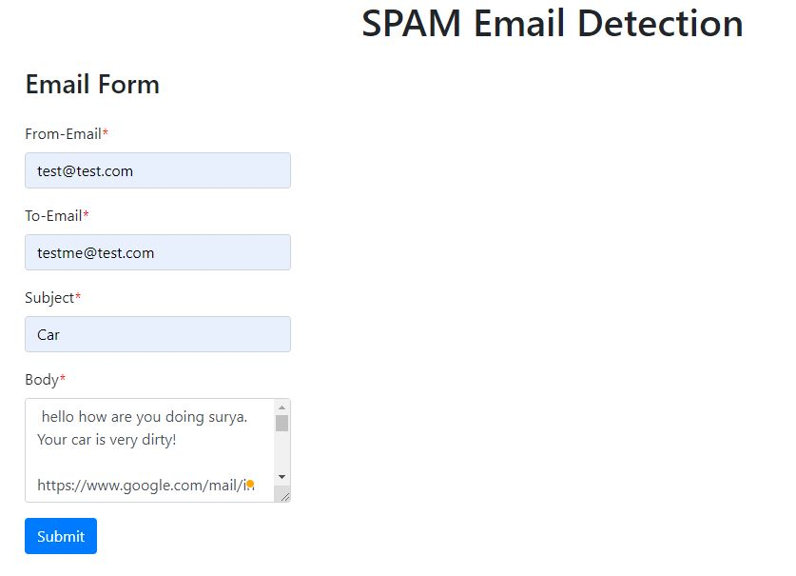
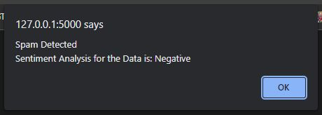

SCREENSHOTS:

Slide 18
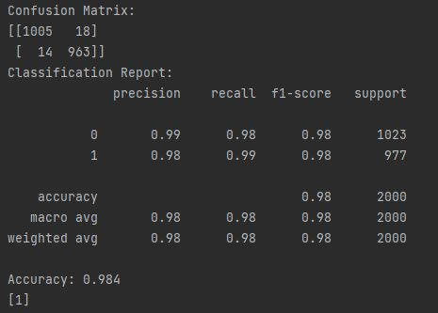
SCREENSHOTS:

Slide 19
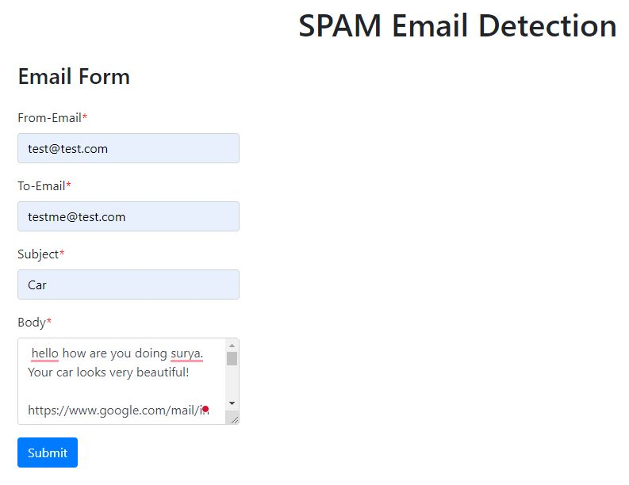
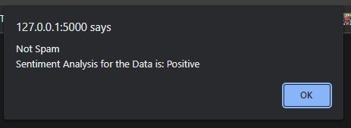

SCREENSHOTS:

Slide 20
RESULTS AND DISCUSSION
Here, we are doing the sentiment analysis
Tokenization
Regular Expression
Text Classification

Slide 21
FUTURE WORK
Discussion of the potential improvements that can be made to the model, such as incorporating more advanced feature engineering techniques, exploring other machine learning algorithms, and using deep learning methods
Explanation of the limitations of the current approach and how they can be overcome
Description of potential applications of the model, such as email filtering, spam detection in social media, and sentiment analysis in customer feedback

